Slide 1
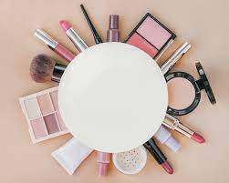
GLAMM-UP BEAUTY APP
GLAMM-UP GROUP
Project done by
Navjot kaur,
Anjali malviya.
Bhuvaneshwari and
Subhadra.

Slide 2

ABOUT GLAMM-UP
To make yourself look especially
Attractive we want everyone look specially .

Slide 3

GLAMM-UP FEATURES
SEARCH BAR : The location within a browswr that allows you to search the internet for what you want to find.
HOME : A home page is tha main page of a website.
CATEAGORIES : Thinkg regarded as having particular shared characteristics.

Slide 4

<a href></a> : for attech link.
<img src> : for attech img link.
<input type> : for give button.
<center></center> : write the text in center. bgcolor : for background color.\
&nbsp:for space
<br>:for new line
USE OF TAG

Slide 5

THANK YOU

